Slide 1
PSTs’ Experiences with and Attitudes about Video Games
Sam von Gillern, Xinhao Xu, Carolyn Stufft, & Hillary Gould

Slide 2
Background
Why Video Games?
  Game-based learning can be an effective approach to help students learn content and skills in a variety of disciplines (Clark et al., 2016)
Preservice teachers will soon have classrooms of their own
  It is important to develop an understanding of PSTs’ experiences with and attitudes about video games
  These experiences and perspectives influence if and how game-based learning is utilized in their classrooms
Notes:
Show of hands - who in here plays video games? Get them thinking about future questions at end
Talk about my experience
Why do you think you play video games? Do you use them in your classroom? How?
Possibility for games in everything

Slide 3
Literature Review
Video games are an important part of youth culture
  Over 90% of children in the United States ages six to 17 play video games (NPD Group, 2020)
GBL can lead to student learning in various educational environments and content areas
  Positive learning gains and experiences demonstrated in disciplines including mathematics (Tokac et al., 2019), literacy (Marlatt et al., 2021), social studies (Hwang et al., 2015), and second-language acquisition (Author, 2020)

Slide 4
Literature Review
GBL leads to greater learning outcomes than non-game conditions (Clark et al., 2016)
  Higher intrapersonal learning outcomes:
    motivation, intellectual openness, work ethic and conscientiousness, and positive core self-evaluation
Some research has examined educators’ attitudes about integrating video games as instructional tools (Misfud et al., 2013)
  Limited examination of the gaming experiences of PSTs and their broader attitudes about games in general

Slide 5
Research Question
PSTs’ attitudes about video games can reveal perceived value of games in both entertainment and educational contexts
What are preservice teachers’ experiences with and attitudes about video games?
What are preservice teachers’ experiences with and attitudes about video games?

Slide 6
Methods
Survey design research approach (Johnson & Christenson, 2013)
25 survey items drawn from the Demographic and Player Attitudes (DAPA) Survey (Homer et al., 2012)
50 PSTs completed a unit on digital literacies in their literacy methods course that included GBL and opportunities for integrating games into their future teaching
Survey responses collected via Google Forms
Data analyzed and examined by patterns of participants’ video gaming experiences and their attitudes on video games

Slide 7
PSTs’ Gaming Habits

Slide 8
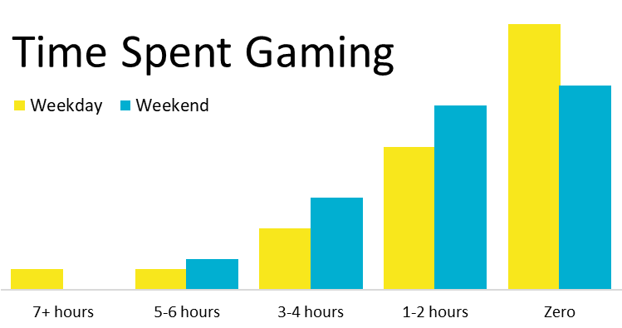
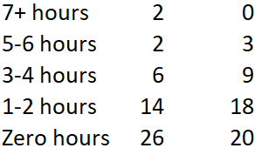
Frequency and Duration of Play
Notes:
On a typical weekday/weekend, how many hours do you spend playing games on a digital device?
Weekday Weekend
7+ hours 2 0
5-6 hours 2 3
3-4 hours 6 9
1-2 hours 14 18
Zero 26 20

Slide 9
Frequency and Duration of Play
Most participants (52%) do not play video games during the weekdays, and a plurality (40%) do not play video games on the weekends
  20 participants (40%) indicated they do not play at all on a typical weekend or weekday
  six participants (12%) indicated they play on weekends but not weekdays
Many PSTs have limited experience and engagement with video games, which likely influences their familiarity with games and how easy it is for them to use games

Slide 10
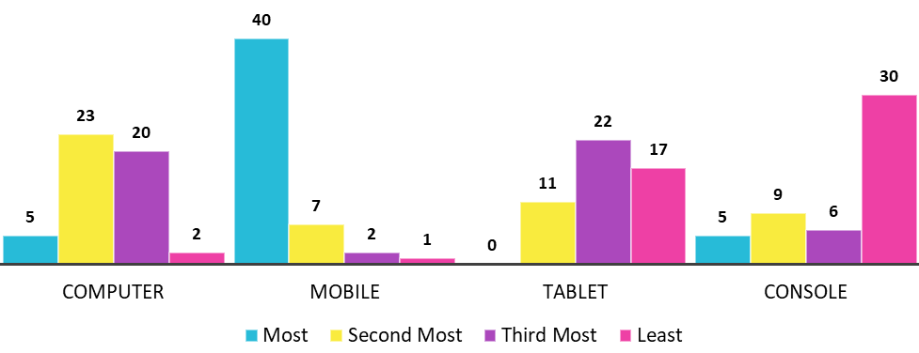
Most Used Digital Device for Gaming

Slide 11
Attitudes About Games

Slide 12
Perceptions About Self & Video Games
Many PSTs themselves did not play video games, but these same participants had many positive views on video games:
  Can teach them things (78% agreed, 4% disagreed)
  Help them become a team-player (64% agreed, 16% disagreed)
  Allow them to feel how it is like to live like someone else (56% agreed, 20% disagreed)
  Video games are fun (80% agreed, 10% disagreed)

Slide 13
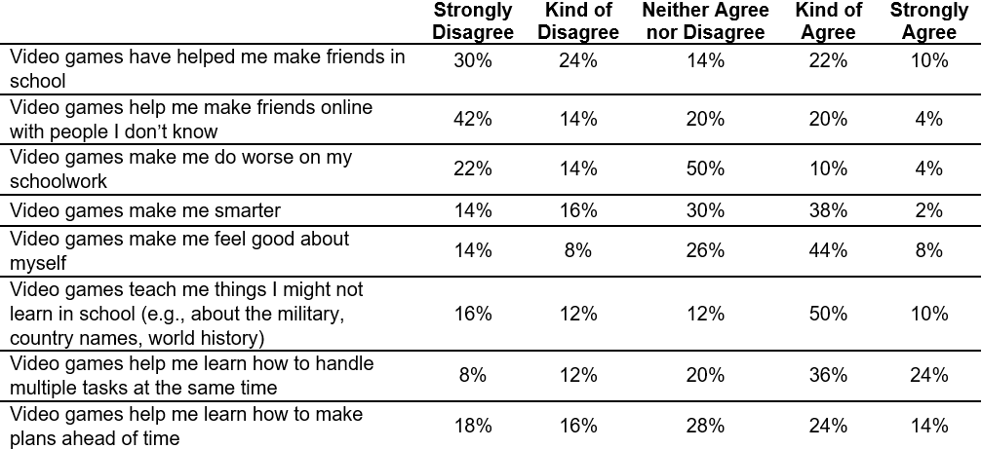
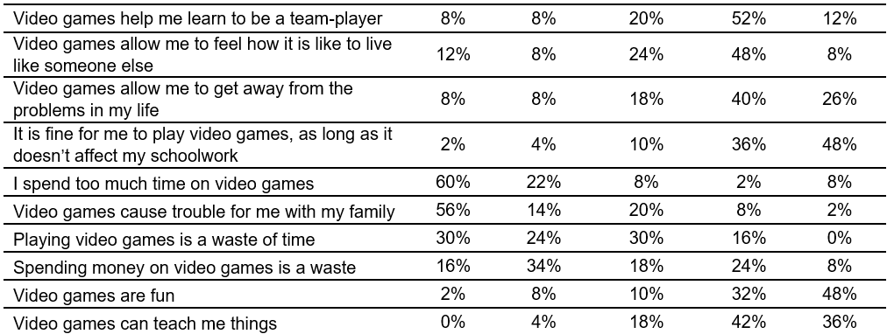
Perceptions About Self & Video Games

Slide 14
Perceptions About Self & Video Games
Approximately 1/3 of participants thought spending money on video games is a waste
  A substantial portion of participants devalue the social practice of video gaming, a prominent recreational activity that 90% of school age children in the US engage with
  Low perceived value is problematic
    perceived value and usefulness of utilizing educational technology influences the likelihood and degree of integration
Notes:
50% disagreed, but 30% is a very high number to agree

Slide 15
Perceptions About Self & Video Games

Slide 16
Discussion

Slide 17
Discussion
There is a disconnect between the gaming patterns of children and PSTs’ gaming habits
This means that many children will be more familiar and skilled with gaming than their teachers, which might lead to lower usage (Author, 2021b)
  Educators can be uncomfortable being less knowledgeable and skilled than their students when integrating games into their teaching

Slide 18
Discussion
The concept of video games is not specifically detailed or discriminated based on either the game genres or the technology platforms
It is critical that teacher preparation programs help not only convey the effectiveness of GBL, but also provide concrete and practical strategies for integrating video games into the classroom
  Help educators see the usefulness of GBL and increase the perceived ease of use with GBL (Scherer et al., 2019)
    Two factors that most impact the use of ed tech

Slide 19
Future Research
Examine the experiences and attitudes of both PSTs and in-service educators to develop an understanding of their familiarity and perspectives as well as their readiness and willingness to integrate such technologies into their teaching
Investigate educators’ experiences, attitudes, and strategies for implementing games in their classrooms
  Prepare educators to effectively utilize video games and other educational technologies
Notes:
Plug here about Tuesday 1:45 presentations that address this future research?

Slide 20
Questions for You
What are your gaming habits? How do you feel this influences usage of digital game-based learning in your practice?
How do you feel about games in your life? In what ways do you think gaming influences you outside of work?

Slide 21
Questions for Us?

