Slide 1

Literacy educators’ attitudes on video games and learning
Literacy educators’ attitudes on
video games and learning
Sam von Gillern – University of Missouri
Brady Nash – Miami University
Carolyn Stufft – Berry College
Hillary Gould – University of Missouri
Sam von Gillern – University of Missouri
Brady Nash – Miami University
Carolyn Stufft – Berry College
Hillary Gould – University of Missouri

Slide 2
Overview
Digital game-based learning (GBL) has been examined in a variety of disciplines
Meta-analyses illustrate the efficacy of GBL in general (Clark et al., 2016, Wouters & van Oostendorp, 2013), as well as in specific content areas:
  science (Lei et al., 2022), math (Tokac et al., 2019), and TESOL vocabulary acquisition (Thompson & von Gillern, 2020)

Slide 3
Purpose
While GBL has been explored in various disciplines, research on GBL in literacy instruction and learning is limited
Teachers, including literacy educators, are key gatekeepers who decide if, how, and when GBL is integrated in literacy instruction
We examine the attitudes of 328 elementary literacy educators to understand their perceptions on games and learning, as these perceptions may influence if and how they integrate GBL into their literacy teaching

Slide 4
Literature Review – GBL In Literacy
Serious Games
  promote the learning of foundational literacy skills including phonological awareness, spelling, and decoding (van Gorp et al., 2017; Kyle et al., 2013)
Entertainment Games
  support literacy practices (Harvey, 2018; von Gillern & Stufft, 2022)
    interpreting various forms of communication (written language, oral language, abstract symbols, dynamic visuals, sound effects, etc.)
    serve as a focus for textual engagement and analysis via creating game reviews, discussion groups, game critiques, & strategy guides

Slide 5
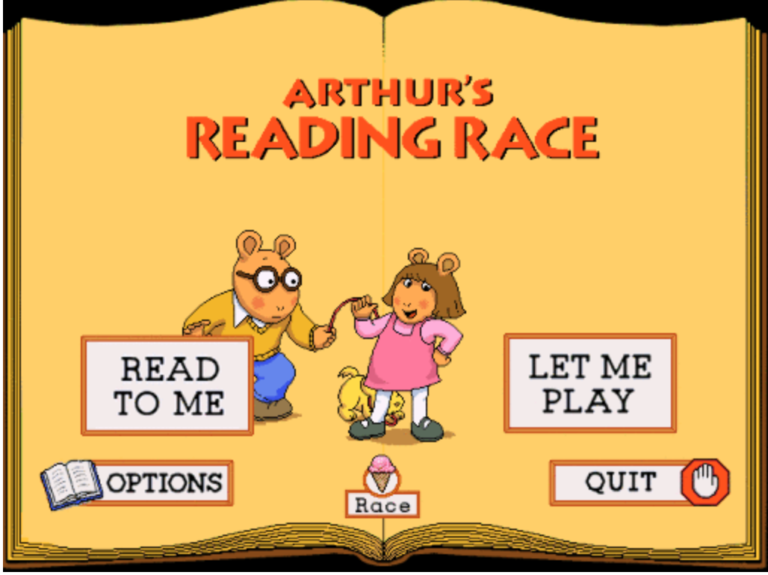
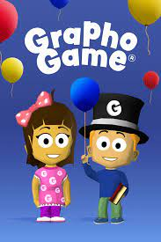
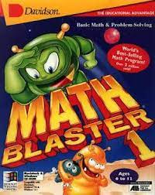
Serious Games

Slide 6


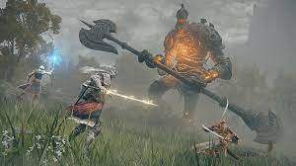

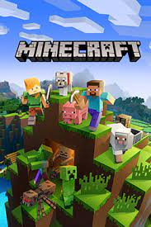


Entertainment Games

Slide 7
Literature Review – Teachers’ Perceptions
Teachers’ perceptions and conceptualizations of video games play a large role in whether and how students are provided opportunities to engage in these new literacies (Beavis et al., 2017)
Beavis et al. (2014, p. 569) explain:
  “Teachers’ beliefs about what it is (or is not) possible to achieve with digital games in educational contexts will inevitably influence the decisions that they make about how, when, and for what specific purposes they will bring these games into their classrooms.”

Slide 8
Methodology
Survey Design Methodology (Dillman, 2011)
  “nonexperimental research based on questionnaires or interviews,” was utilized for this study (Johnson & Christensen, 2013, p. 249)
Research Question:
  What are elementary literacy teachers’ attitudes on video gaming and learning?

Slide 9
Methodology – Survey Design
Reviewed existing surveys and concepts from the literature
  Drew on items from Homer et al.’s (2012) Demographics, Attitudes, and Player Activity (DAPA) survey and Noraddin and Kian’s (2014) survey on digital games for teaching
Some items were modified for clarity and to become tailored to the target audience of this study (i.e., literacy teachers) & new items created
  Survey item “I spend too much time on video games” was changed to “Children spend too much time on video games”
  “Digital games are a form of media worthy of analysis in English language arts classrooms” was added
Notes:
Some items were modified for clarity and to become tailored to the target audience of this study (i.e., literacy teachers).
For example, Homer et al.’s study was developed to be given to children, and thus, we modified some items to shift to a format appropriate for the target audience (e.g., the survey item “I spend too much time on video games” was changed to “Children spend too much time on video games”).
We created new items as well (e.g., “Digital games are a form of media worthy of analysis in English language arts classrooms”).

Slide 10
Methodology – Survey Validation
A panel of four experts as well as four teachers reviewed the survey questions and provided feedback on the content and clarity of the survey items
This feedback was used to refine the survey’s clarity and create additional items aligned with research goals to create the final survey

Slide 11
Methodology – Survey Validation
The final survey contained 37 items that examine participants’
  General perceptions of video games
  Attitudes on digital game-based learning
  Perspectives on utilizing games for literacy teaching and learning
Consists primarily of five-point Likert scale items and also includes demographic items

Slide 12
Methodology – Survey distribution
The survey was distributed to literacy teachers in a Midwestern state in the United States through email distributed via Qualtrics.
Over the following two weeks, three reminder emails were sent as well. In total, 328 elementary literacy teachers completed the survey

Slide 13
Methodology – Survey Analysis
Any survey that did not have 100% of items completed was excluded from analysis
The data were analyzed by examining the distribution and frequency of participant responses as well as overall trends in their perspectives (Iarossi, 2006)

Slide 14
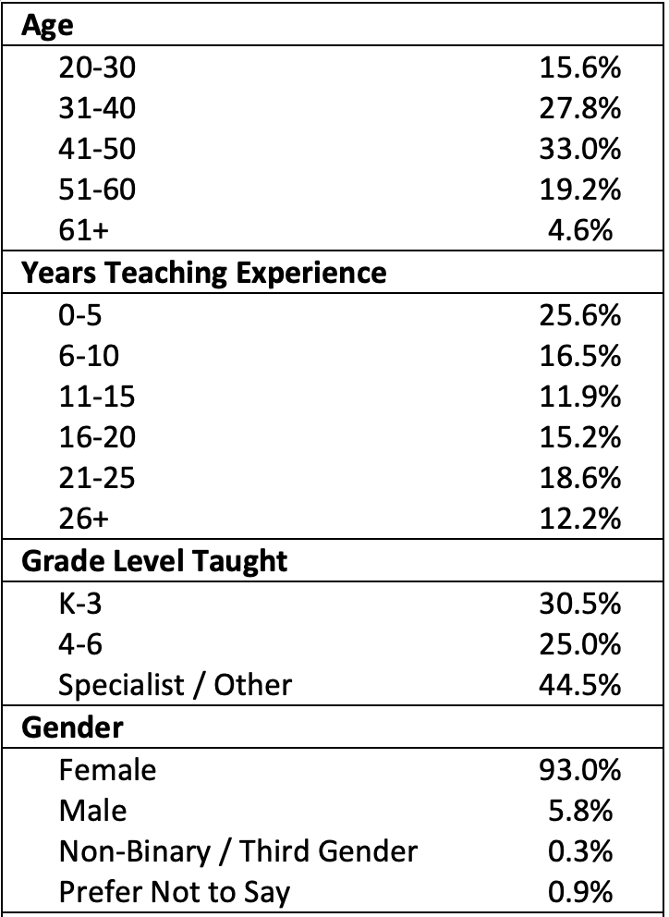
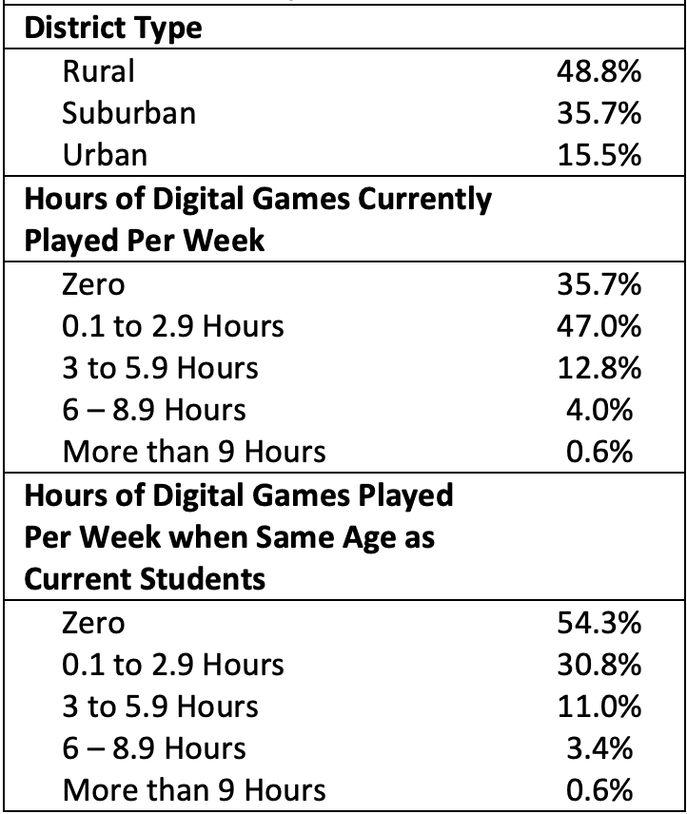
Participant Demographics

Slide 15
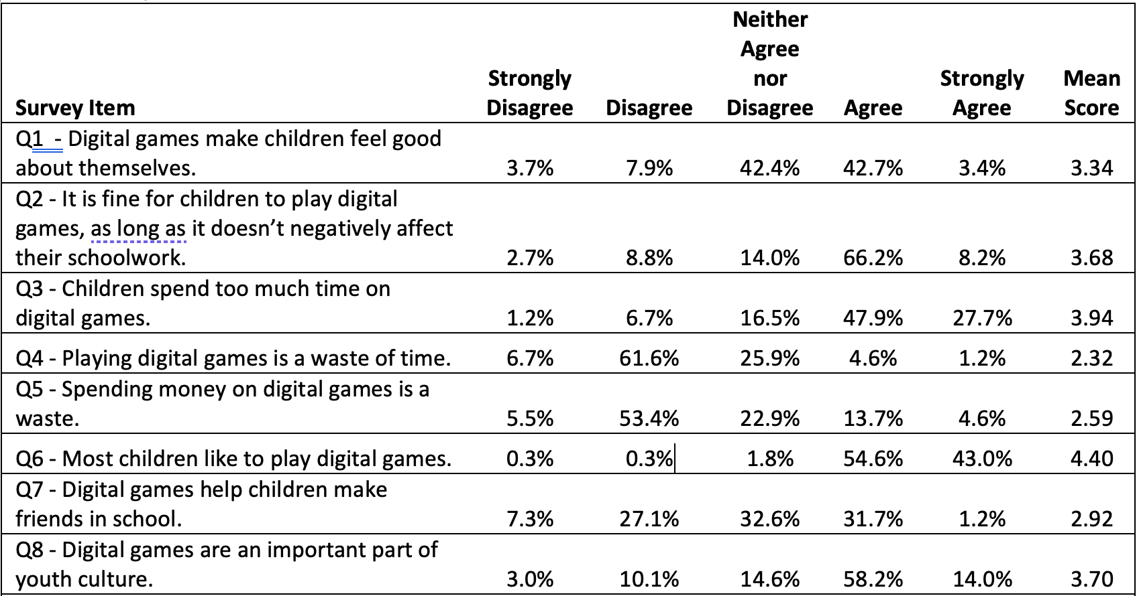
Results

Slide 16
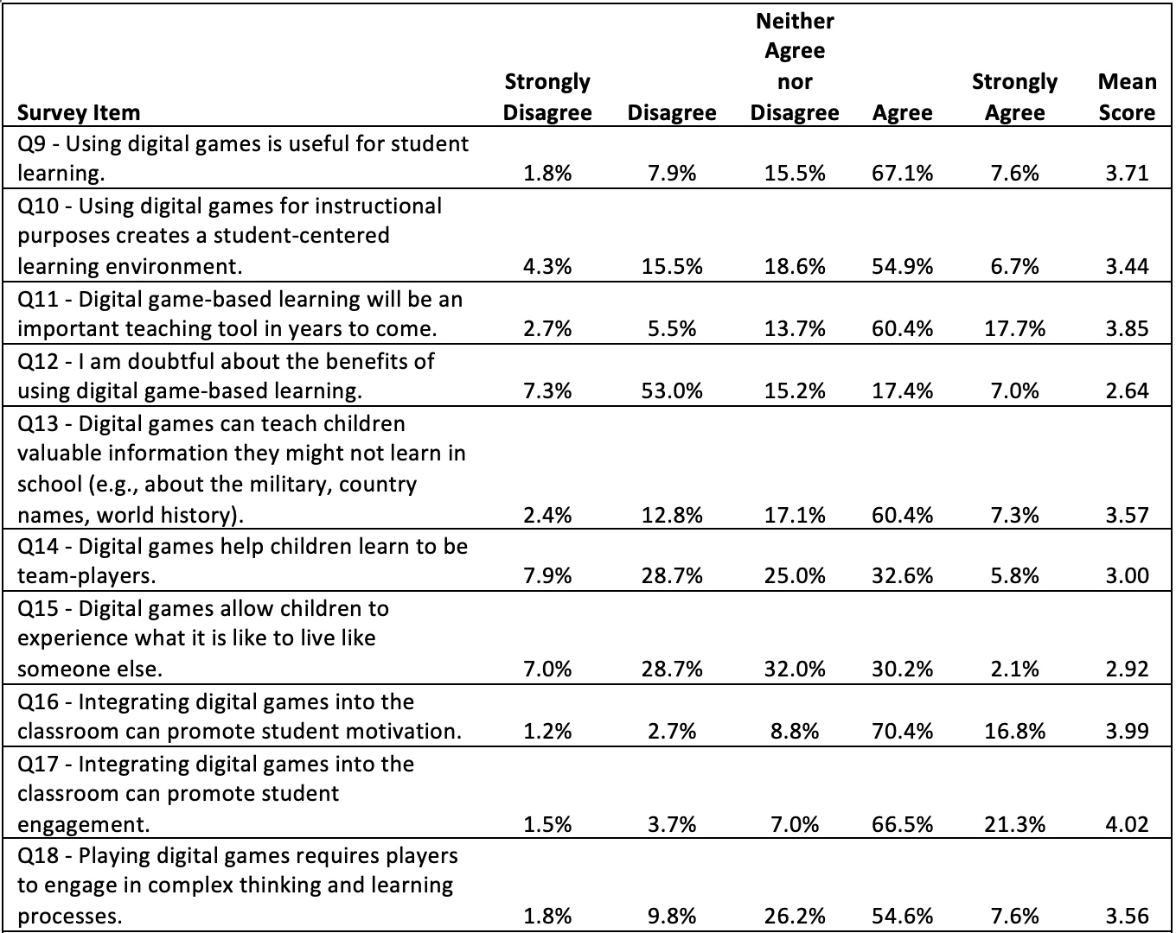
Results

Slide 17
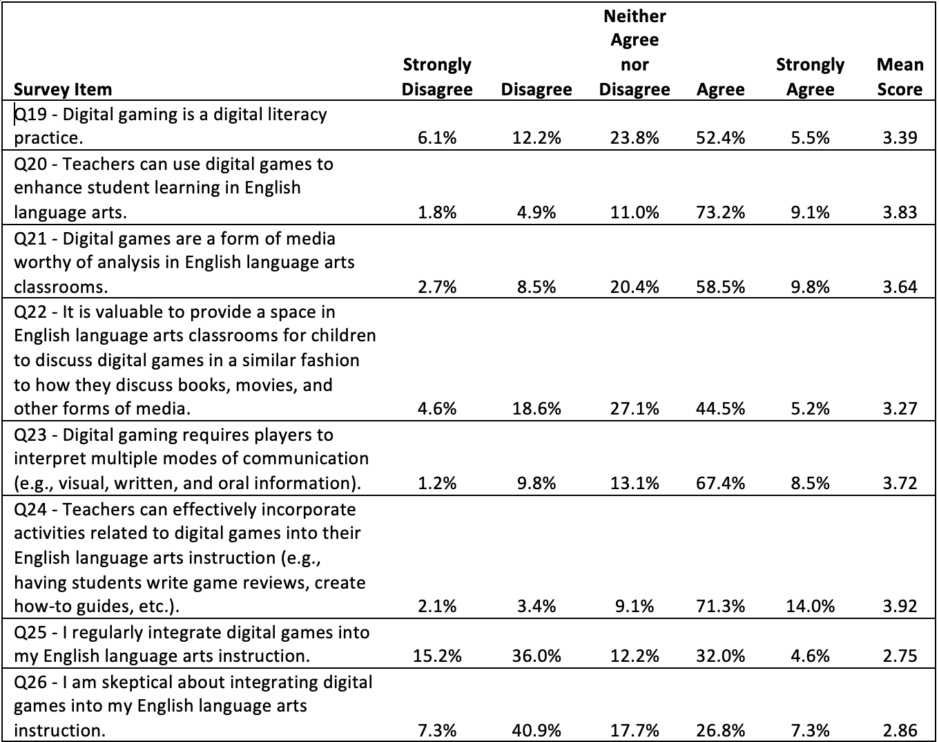
Results

Slide 18
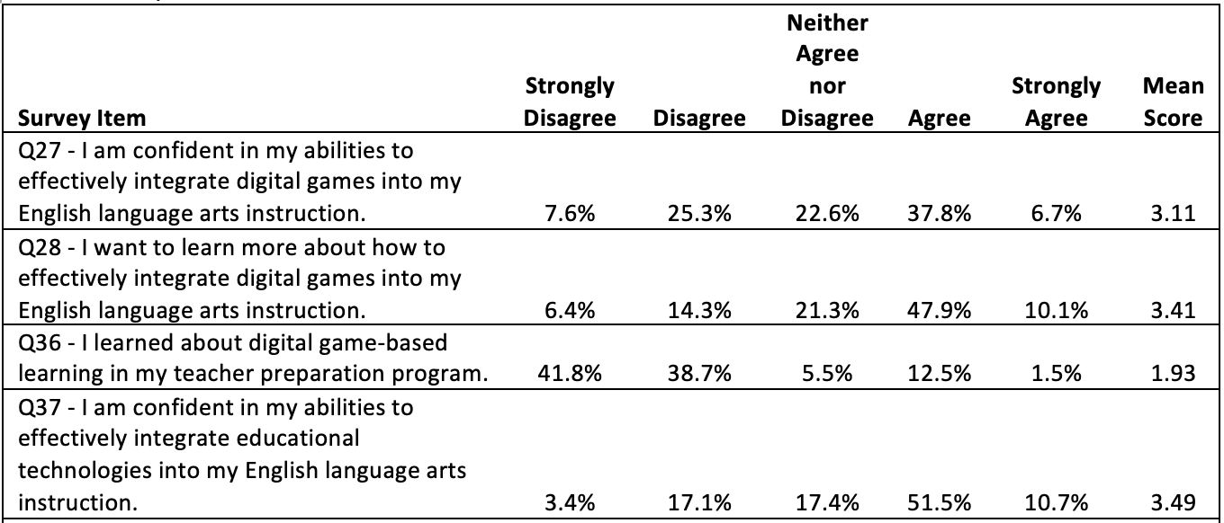
Results

Slide 19
Notable Results
Results indicate that the teachers believe children enjoy playing video games, view games as an important aspect of youth culture, and generally believe that video games can promote student motivation, engagement, and learning.
However, only 37% of participants either agreed (32.0%) or strongly agreed (4.6%) that they regularly integrated video games into their literacy teaching and approximately a third were skeptical about integrating video games into their literacy teaching (26.8% agreed and 7.3% strongly agreed).

Slide 20
Notable Results
57% were interested in learning more about how to effectively integrate video games into their literacy teaching (47.9% agree and 10.1% strongly agreed).
This finding makes sense given that only 14% of participants indicated they learned about digital game-based learning during their teacher preparation programs.

Slide 21
Discussion
Participants’ positive views on learning through video games aligns with existing reviews of research that demonstrate the effectiveness of game-based learning in a variety of content areas (Clark et al., 2016; Thompson & von Gillern, 2020; Wouters & van Oostendorp, 2013)
Given that teachers’ views largely align with research that demonstrates games can be effective at promoting student learning in a variety of disciplines, professional development is needed to help teachers develop their abilities to effectively integrate video games into their literacy teaching

Slide 22
Limitations
This study focused on 328 elementary literacy teachers from a Midwestern state in the US
Further survey research is needed to understand the attitudes of educators in different contexts as relates to video gaming and learning
Additional research needs to examine more than attitudes, including specific video gaming activities in literacy contexts (Abrams, 2017; Gerber & Price, 2013)

Slide 23
Conclusion
Research demonstrates that GBL is effective in a variety of disciplines and instructional contexts (Clark et al., 2016; Thompson & von Gillern, 2020; Wouters & van Oostendorp, 2013)
This research demonstrates that teachers believe GBL is effective, but do not frequently integrate it into their literacy instruction, though they want to learn more about effective practices for classroom integration
Thus, teacher-preparation and professional programs need to 1) demonstrate the efficacy of GBL, and 2) provide specific activities, ideas, and strategies for literacy classroom implementation

Slide 24

Questions?
Thanks for listening!
Scan the QR code to see more articles by Sam and Hillary.
We’d be happy to hear from you.
svongillern@gmail.com
hgould@missouri.edu

