Slide 1
A Systematic Review of
Video Game Research in Literacy Journals
European Conference on Games-Based Learning
Sam von Gillern & Hillary Gould
University of Missouri

Slide 2
Game-Based Learning
Digital games can lead to substantial learning outcomes in a variety of disciplines (Granic et al., 2014; Wouters et al., 2013)
Digital games can promote student motivation (Clark et al., 2016), a factor that influences learning (Hattie, 2009)
Existing research reviews:
  mathematics (Tokac et al., 2019)
  second language acquisition (Chen et al., 2018)
We utilized a systematic review methodology (Khan et al., 2003), guided by the research question:
  What literature on video games exists in literacy journals?

Slide 3







Entertainment Games

Slide 4
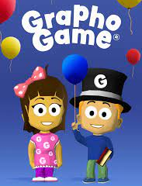
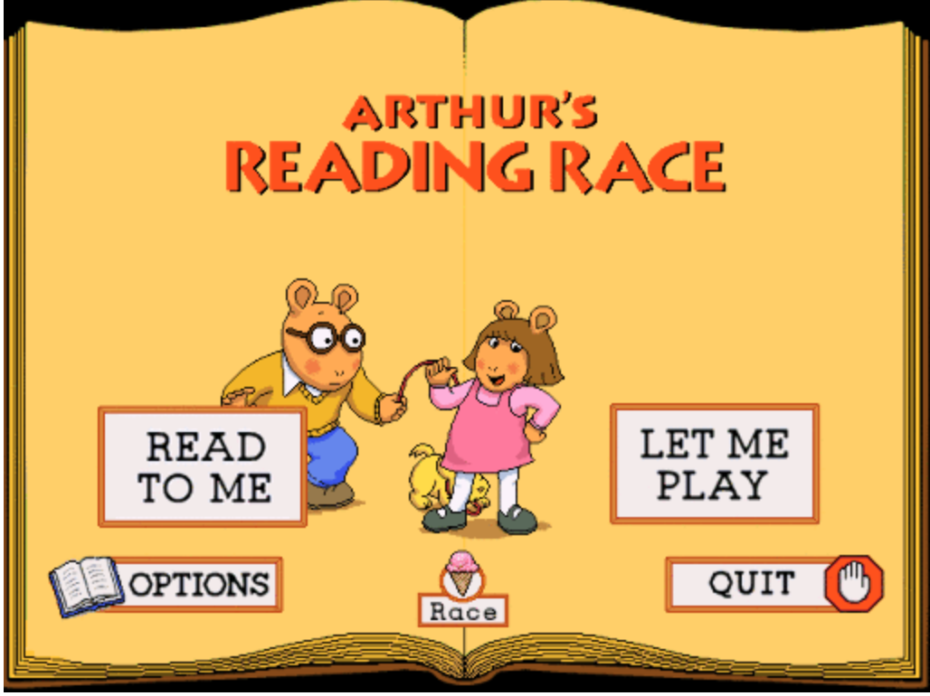
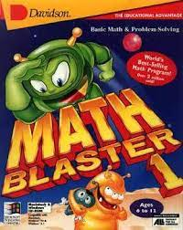
Serious Games

Slide 5
Game-Based Learning
Entertainment games
  designed primarily for entertainment purposes
Serious games
  designed primarily for educational and training purposes (Alvarez & Djaouti, 2011)
While some research has examined video games in literacy and English language arts classrooms, most of the game-focused education research examines other content areas (Wouters et al., 2013).

Slide 6
GBL in Literacy
Gaming involves a “constellation of literacy practices” (Steinkuehler, 2007, p. 207)
  video gaming and in-game communication are complex processes
  Illustrated by (Gee, 2003; Squire, 2014; von Gillern, 2016a)
Literacy practices involved with gaming and game communities has been examined in a variety of ways:
  literature/game circles (Harvey, 2018)
  literary analysis (Marlatt, 2018)
  multimodal analysis of games as texts (Stufft & von Gillern, 2021)

Slide 7
GBL in Literacy
Existing research:
  how video games can promote literacy learning through gaming itself and via game-related activities
This study:
  a systematic review of the literature that examines literacy journals to develop an understanding of what body of video game research exists in the field of literacy research
Purpose:
  illuminate the current state of research and body of literature

Slide 8
Methodology
Systematic review methodology (Khan et al., 2003)
  establishes a research goal
  develops inclusion and exclusion criteria to systematically review literature on the topic
  synthesizes the findings of existing literature (Denyer & Tranfield, 2009)
This study aimed to develop an understanding of the research base on video games in literacy journals.

Slide 9
Methodology
To this end, 13 literacy journals were included in the search which were utilized in Parson’s et al. (2020) review of lit research journals
Journal of Adolescent and Adult Literacy |  | Reading & Writing Quarterly
Journal of Literacy Research | Journal of Research in Reading | Research in the Teaching of English
Literacy Research and Instruction |  | Reading Research Quarterly
Language Arts | Reading Psychology | Scientific Studies of Reading
English Journal | Reading and Writing | The Reading Teacher

Slide 10
Phase 1 – Initial Search
168 total articles matched search criteria
  Searched 13 journals
  Publications in the 2000-2020 range
  Searched abstracts using the search term “gam*”, which would include any mention of games, including digital, video, computer, mobile, etc.
  Duplicates removed
Only original articles were included. Book reviews, editorials, and the like were excluded.

Slide 11
Phase 2
Video Games Mentioned in Abstract
57 total articles included
  Searched abstracts for mentions of games including video games, computer games, digital games, and mobile games
  If the abstract referenced a type of digital game in the abstract, it was included in the next phase.

Slide 12
Phase 3
Total Articles that Met Inclusion Criteria
43 articles included at least five mentions of games in their text
  Full articles were examined
If the article was not clearly about video games and had less than five mentions of games in the text, then the article was excluded
  Purpose: remove articles that briefly mentioned games but did not devote significant attention to the use of games
  Often occurred when authors mentioned pop culture
If an article had at least five mentions of video games, then it was included

Slide 13
Phase 4
Sorted Articles into Two Groups of Studies
The 43 articles were sorted:
  Primary focus of article was on Video Games
    32 Articles
  Video games were included, but primary focus was on other topic, such as popular culture, transmedia, internet behaviors, etc.
    11 Articles

Slide 14
Phase 5
Sorted Video Game Articles into Two Groups of Studies
The 32 articles were sorted:
  Focus on Entertainment/Commercial/Off-the-Shelf Games
    15 Articles
  Focus on Serious Games
    17 Articles

Slide 15
Coding
Phases 1 through 3
  conducted by a single researcher as the inclusion criteria was straight-forward
    e.g., if games were mentioned at least five times in an article, then it was included in Phase 3
Phases 4 and 5
  more subjective decision making
  coded by two different researchers to promote interrater reliability (Belur et al., 2021)

Slide 16
Coding
Phase 4
  6 initial disagreements of 43 articles
Phase 5
  1 initial disagreement of 32 articles
All disagreements were resolved through discussion

Slide 17
Results: Entertainment Games
15 Articles focused on entertainment games
  explored how children can engage with various literacy practices through both playing games, exploring game narratives, and engaging in game-related activities, such as discussing, writing, and creating videos about games, such as Pokémon GO, Minecraft, and The Last of Us (Abrams & Russo, 2015; Beavis, 2014; Howell, 2017)

Slide 18
Results: Entertainment Games
15 Articles focused on entertainment games
  For example, Gerber & Price encourage teachers to use “popular video games to engage students in authentic expository, persuasive, and creative writing” (p. 68), and Marlatt (2018) how students can use Minecraft to engage in textual analysis and develop their literacy identities.

Slide 19
Results: Serious Games
17 Articles focused on serious games
  focused largely on helping students develop basic literacy skills such as spelling, phonics, and word knowledge (Bhide et al., 2019; McTigue et al., 2020)
  games explored in these articles included Living Letters, GraphoGame Phoneme, and Reading Race.

Slide 20
Results: Serious Games
17 Articles focused on serious games
  Kyle et al. (2013) found that video game conditions led to larger reading, spelling, and phonological skill learning outcomes than control groups
  van Gorp et al. (2017) found that word and pseudoword reading game led to significant decoding improvement for second-grade children with reading difficulties

Slide 21
Results: Serious Games
17 Articles focused on serious games
  Some articles examined games that focused on literacy practices connected to science and social study topics, such as the spread of disease (Spires, 2015) and argumentation in environmental action (Sherry & Lawrence, 2019)

Slide 22
Results: Methodologies
Methodologies for included articles:
Methodology | Number of Articles
Quantitative | 10
Qualitative | 1
Mixed Methods | 13
Conceptual (draws from specific study) | 13
Conceptual (draws from general research) | 6

Slide 23
Results: Methodologies
Quantitative studies were primarily in research-focused journals, such as Reading Research Quarterly, Reading & Writing, and Journal of Research in Reading
  studies focused exclusively on serious games aimed at promoting literacy development
There was a single qualitative study that included a dedicated methods section (Marlatt, 2018)

Slide 24
Results: Methodologies
Only one qualitative study of research on video games in the 13 literacy research journals over a 21-year period of time
  qualitative methods were used in conceptual practitioner articles
    valuable and help their audiences understand video gaming in its relation to teaching and learning
    did not include a dedicated methods section
    methods for these were typically described briefly
Notes:
To reiterate, there is only one qualitative study of research on video games in the 13 literacy research journals over a 21-year period of time. While qualitative methods were used in conceptual practitioner articles and these articles are valuable and help their audiences understand video gaming in its relation to teaching and learning, those articles did not include a dedicated methods section and methods for these were typically described briefly

Slide 25
Discussion
Serious Games
  Largely had positive affects on learning of foundational literacy skills, aligning with existing quantitative GBL studies (Clark et al., 2016, Wouters & van Oostendorp, 2013)
  Primarily in research-focused journals
Entertainment Games
  Promoted student motivation and engagement, two factors that impact learning (Hattie, 2009)
  Primarily focused in practitioner-focused journals

Slide 26
Discussion
Only 32 video game articles of several thousand from the 13 journals over a 21-year period of time
Most rigorous studies were quantitative and focused on serious games
Only 1 qualitative study with a methods section
We need rigorous studies of games children actually play.

Slide 27
Directions for Future Research
High-Quality Qualitative Studies
  Entertainment Games
  Video Game Analysis
  Game Reviews
  Game Critiques
  Literature Circles
Serious Games and Foundational Literacy Skills

Slide 28
Conclusion
Given the massive popularity of video gaming with young people around the world, literacy scholars need to increase video game research if literacy research is going to reflect the interests and passions of young people and align with their out-of-school literacy practices (Morrell, 2002; 2004).

Slide 29

Questions?
Thanks for listening!
Scan the QR code to see more articles by Sam.
We’d be happy to hear from you.
svongillern@gmail.com
hgould@missouri.edu

